Slide 1
Digital Portfolio
STUDENT NAME: RASHITHA BANU S
REGISTER NO AND NMID: 2422K0951/DF28350ED4C5B68977F4D07915810DE
DEPARTMENT: BSC.COMPUTER SCIENCE
COLLEGE: TIRUPPUR KUMARAN COLLEGE FOR WOMEN/BHARATHIYAR UNIVERSITY

Slide 2
PROJECT TITLE
MY CYBER SECURITY PORTFOLO

Slide 3


AGENDA
Problem Statement
Project Overview
End Users
Tools and Technologies
Portfolio design and Layout
Features and Functionality
Results and Screenshots
Conclusion
Github Link
3/21/2024 Annual Review

Slide 4

PROBLEM STATEMENT
In today’s competitive cyber security field, professionals and learners need a digital platform to showcase their skills, projects, and expertise. Many resumes fail to highlight practical knowledge in areas like ethical hacking, penetration testing, and network defense. Without an interactive portfolio, recruiters and peers may not recognize a candidate’s true capabilities.

Slide 5

PROJECT OVERVIEW
The Cyber security Portfolio Website is a personal digital platform designed to showcase my skills, projects, and knowledge in the field of cyber security. It is built using HTML, CSS, and JavaScript with a modern dark theme UI.
The website includes the following sections:
About Me – Introduction and career goals in cyber security.
Projects – Displays practical projects, such as a Password Strength Checker (implemented with JavaScript) and descriptions of network security tools.
Skills – Lists core cyber security and programming skills like penetration testing, ethical hacking, and risk assessment.

Slide 6

WHO ARE THE END USERS?
1. Recruiters / Employers
They can view the portfolio to assess cyber security knowledge, projects, and skills before offering internships or job opportunities.
2. Peers & Mentors
Fellow students, colleagues, and mentors can explore the projects to provide feedback, collaboration, or learning support.
3. Clients (if freelancing)
Potential clients can see cyber security services (like penetration testing, vulnerability assessment) and decide to hire.
4. The Developer (Yourself)
You use the portfolio as a personal branding tool to track your projects, showcase growth, and maintain a digital resume.

Slide 7



TOOLS AND TECHNIQUES
Tools Used
1. HTML5 – For structuring the content of the website.
2. CSS3 – For styling, layout design, and responsive UI.
3. JavaScript (ES6) – For adding interactivity (e.g., password strength checker
Techniques Applied
1. Responsive Web Design – Ensures the website works on desktop, tablet, and mobile devices.
2. Dark Theme UI – Professional look that aligns with the cybersecurity theme.
3. Navigation & Linking – Smooth movement between sections (About, Projects, Skills, Contact).
4. Interactive JavaScript Function – Password Strength Checker for demonstrating cybersecurity awareness
5. Modular Design – Divided into sections (cards for projects, lists for skills) for clarity.

Slide 8
POTFOLIO DESIGN AND LAYOUT
The design of the Cybersecurity Portfolio Website follows a clean, professional, and user-friendly structure with a dark theme, which reflects the cybersecurity domain.
Overall Layout
Header Section
Contains the portfolio title (“My Cybersecurity Portfolio”).
Includes a navigation bar with links to different sections: About, Projects, Skills, Contact.
Main Body (Sections)
1. About Me
A short introduction describing career goals and interest in cybersecurity.
2. Projects
Showcases projects with details.
Includes an interactive Password Strength Checker built using JavaScript.
3. Skills
A list of cybersecurity and programming skills (Ethical Hacking, Penetration Testing, Python, etc.).
4. Contact
Contact details with Email, LinkedIn, and GitHub profile links.
Footer Section
Displays copyright information.
2. Design Elements
Theme: Dark background with contrasting highlight colors (#58a6ff for headings, white/grey text for readability).
Cards: Each project and skill set is shown inside a “card” (box with border and rounded edges).
Buttons: Used for interactivity (e.g., “Try Demo” in projects).
Hover Effects: Navigation links and buttons change color when hovered for be).
8

Slide 9
FEATURES AND FUNCTIONALITY
Key Features
1. Professional Portfolio Structure
Sections for About, Projects, Skills, and Contact to organize information clearly.
2. Dark Theme UI
Cybersecurity-inspired design with a modern and professional look.
3. Responsive Design
The website automatically adjusts to desktops, tablets, and mobile devices.
4. Interactive Password Strength Checker
A mini cybersecurity demo built with JavaScript.
Allows users to test their password strength (Weak / Medium / Strong).
5. Smooth Navigation
Navigation bar for quick access to all sections.
Hover effects for better user interaction.
6. Contact Information
Easy access to Email, LinkedIn, and GitHub links for networking.
7. Project Highlights
Dedicated space to showcase cybersecurity projects with descriptions.
Functionality
User Navigation: Visitors can click on navigation links (About, Projects, Skills, Contact) to directly access sections.
Password Checker Demo: Users can input a password and instantly see its strength evaluated based on length, uppercase letters, numbers, and special characters.
Project Display: Shows cybersecurity tools and research projects to highlight practical knowledge.
Skills List: Displays both technical (cybersecurity, penetration testing) and programming skills.
Contact Links: Visitors can click to directly email or visit LinkedIn/GitHub profiles.

Slide 10
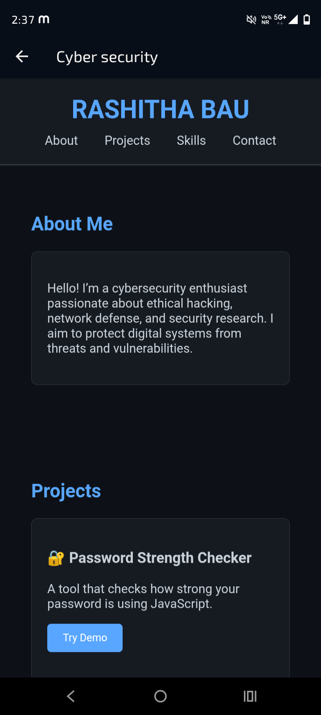

RESULTS AND SCREENSHOTS
3/21/2024 Annual Review
10

Slide 11
CONCLUSION
The Cybersecurity Portfolio Website successfully provides a professional digital platform to showcase my skills, projects, and knowledge in the field of cybersecurity. By using HTML, CSS, and JavaScript, the portfolio combines a clean design with interactive functionality, such as the Password Strength Checker, which demonstrates practical cybersecurity awareness.
This project highlights the importance of having an online presence in today’s competitive environment, especially in technical fields like cybersecurity. Recruiters, mentors, and peers can easily access information about my expertise, projects, and achievements through this portfolio.
The website is responsive, user-friendly, and engaging, ensuring accessibility across devices. It not only serves as a personal branding tool but also as a foundation for adding more advanced cybersecurity projects in the future.
In conclusion, this project has helped strengthen both my web development and cybersecurity presentation skills, while providing a long-term resource to support career growth in the cybersecurity domain.
11

